Slide 1
Skin Cancer
Detection of Benign and Malignant skincancer

Slide 2
AGENDA
CONTEXT
BUSINESS QUESTION
PROJECT PIPELINE
DATA SET
IMAGE PROCESSING
MODELS
FUTURE IMPORVEMENTS

Slide 3
CONTEXT
1
What is the background for this project

Slide 4
Australia has one of the highest rate of skin cancer in the word. It is roughly 2 to 3 times higher than that of the UK, USA or Canada and an estimated 2000 people die from skin cancer each year.

Slide 5
BUSINESS QUESTION
2
What do I hope to achieve with this project

Slide 6
BUSINESS QUESTION
Can we develop a model which will reduce expenses and time spent on biopsy?
END USERs
The general public

Slide 7
DATA QUESTION
Can we from a picture of a mole confidently determine if it’s cancerous?

Slide 8
PROJECT PIPELINE
3
Life cycle of the project

Slide 9
PROJECT PIPELINE
Project Context
Data Acquisition
Modelling & testing
1
3
5
2
4
6
Business question
Data Pre-processing
Stakeholder recommendations

Slide 10
DATA
4
Data used in the project

Slide 11
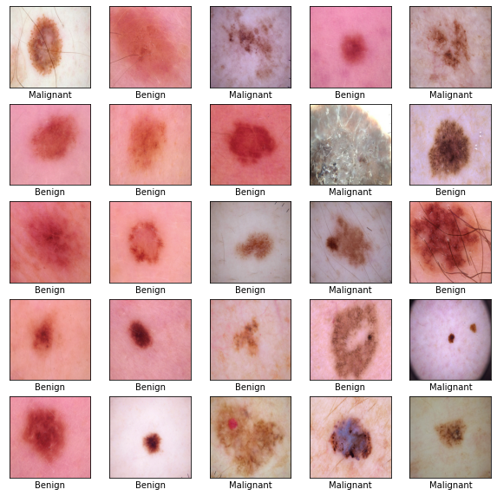
DATA SET
ISIC Archive
3297 pictures
1800 pictures of benign
1497 pictures of malignant
244 x 244 resolusion
Images divided into test and training folder and further into benign and malignant

Slide 12
DATA DISTRUBUTION

Slide 13
DATA PREPROCESSING
5
Preparing our images to use with Deeplearning

Slide 14
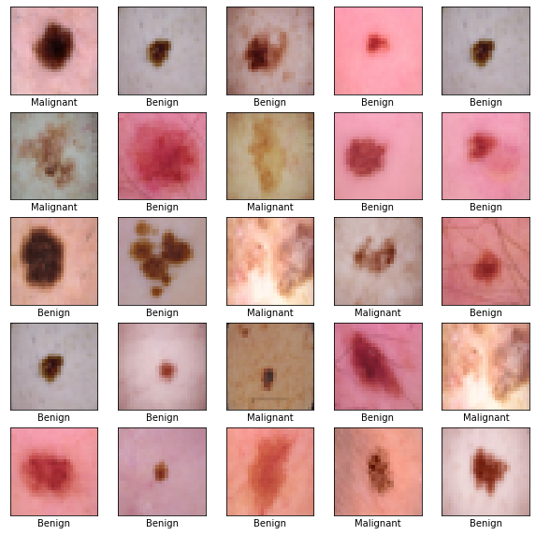
IMAGE PREPROCESSING
Import images
Convert to 32 x 32
Convert to 64 x 64
Set up target array
Normalize the data

Slide 15
Models and preformace
6

Slide 16
MODELS
Algorithm | Accuracy 32 x 32 | Accuracy 64 x 64 | FN
ZeroR (Baseline) | 54% | 54% | 300
CNN | 82.12% | 77.12% | 66 / 128
ResNet50 | 74.55% | 78.18% | 87 / 60
VGG16 | 85.30% | 84.39% | 47 / 44

Slide 17
Convolutional Neural Network (CNN)

Slide 18
Visual Geometry Group (VGG16)

Slide 19
FUTURE IMPORVEMENTS
7
What can we do to improve our model

Slide 20
FUTURE IMPROVEMENTS
Train on larger pictures
Focus on VGG and CNN
Gather data on the background for the patient
Male/Female
Age
Geolocation
Location of mole
Expand model to detect different kind of skin diseases

Slide 21
IMPLEMENTATION
Get the model to a stage where it can be published on a website or via an app

Slide 22
THANKS!
Any questions?

